Slide 1


Semiconductor Packaging:
The Challenges of a Secure Supply Chain
Jeff Demmin (demmin_jeffrey@bah.com)
Booz Allen Hamilton
Microelectronics Integrity Meeting
August 6-7, 2019
Image courtesy of Athena Group

Slide 2
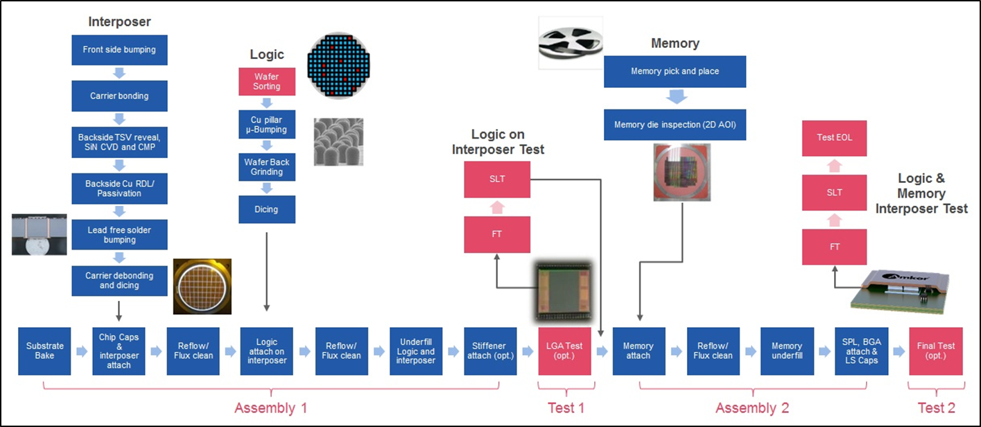
Electronic Manufacturing Supply Chain:
Unavoidably international, even for DoD

Slide 3
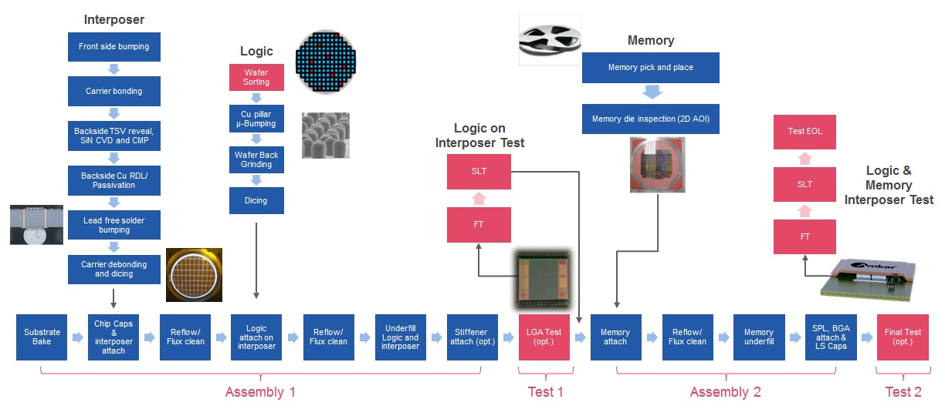
Semiconductor Assembly Example (2.5D HBM):
How many people have access throughout the supply chain?
Interposer design, masks, fab FE, fab BE, test
Substrate design, masks, fab, test
Logic design, masks, fab, test
Assembly 1, test
Logic on interposer test
Memory design, masks, fab, test
Assembly 2, test
Final test
= 5
= 4
= 4
= 2
= 1
= 4
= 2
= 1
23 minimum
Source: “Start Your HBM/2.5D Design Today,” SK Hynix, Amkor, eSilicon, Northwest Logic, Avery Design, 2016.

Slide 4
Semiconductor Assembly Example (2.5D HBM):
How many people have access throughout the supply chain?
Can’t control every step
=> Need combination of trusted resources and in-line checks
Optimal solution varies by assembly flow
=>Need semiconductor packaging process knowledge
Source: “Start Your HBM/2.5D Design Today,” SK Hynix, Amkor, eSilicon, Northwest Logic, Avery Design, 2016.

Slide 5
Microelectronics Innovation for National Economic and Economic Competitiveness (MINSEC): Packaging is critical part of security
Threats and opportunities concentrated at the back end
Solutions needed where all pieces come together
Source: “Long-Term Strategy for DoD Assured Microelectronics Needs and Innovation for National Economic Competitiveness,” K. Baldwin, NDIA, Oct. 2018

Slide 6
“Microelectronics and the Department of Defense: The Way Ahead”
Lisa Porter (DUSD(R&E)) at DARPA’s ERI Summit (July 2019)
“We need to shift our thinking about trust and security.”
“How do you build secure cyber systems? The answer is that you can’t.”
“The right question is how do we operate effectively in systems that are inherently not secure?”
“This philosophical shift is referred to a “zero-trust” model.”
“How do we ensure that the microelectronics that we procure regardless of the source will perform exactly as expected … and how do we ensure that our designs are protected?”
“The Trusted Foundry model is outdated and simply cannot provide the access we need to the most advanced manufacturing capability.”
“Data not perimeters must be the arbiter of the trust that we assign to the electronics that we build.”
“Data collection and analysis methods must be developed and applied along the entire life cycle.”
Source: DARPA MTO ERI Summit; http://www.eri-summit.com/agenda-2019 (links to presentations and videos)

